Slide 1

Liberty Insurance Case Study
Dev: Mateus Broilo da Rocha

Slide 2
Statement of the Problem
Problem:
Presently Liberty Insurance Co. has a very complicated problem regarding lack of trustful knowledge on claims that a policyholder is most likely to file during the exposure time policy.
Formal Statement:
Build a model able to predict the total number of claims a customer is going to file with the company.

Slide 3
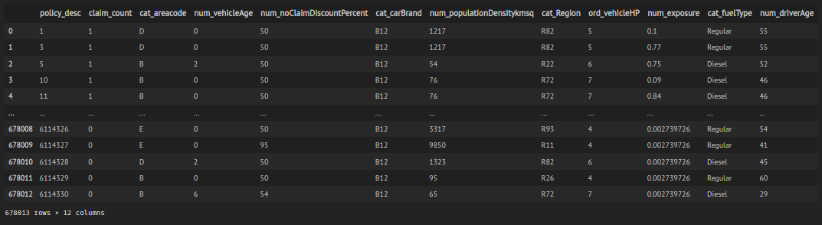
Is there any dataset available?
Yes!
A dataset containing policy info of motor insurance customers and the total claims they have filed.
More Specifically:
This dataset initially contains 12 columns and 678013 rows.
The total number of claims per customer is represented by claim_count.
This column is the TARGET feature.
The expected frequency of claims is calculated by using num_feature (which is an offset variable)
All the rest can be viewed as RESOURCE features.

Slide 4
Tell me more about this data!
Sure thing!
Variables:
Target:
claim_count: Total Claims (This is the response you should predicting); Numeric Variable
Offset:
num_exposure: Exposure time of policy. Time period within which the claims were made; Numerical Variable
Independent:
policy_desc: Policy Identifier; Primary Key which is unique for every policy
cat_areacode: Area Code; Categorical Variable
num_vehicleAge: Age of the vehicle; Numeric Variable
num_noClaimDiscountPercent: Percentage of discount applied to policy premium based on claim history. If value is greater than 100 then policy premium was increased, if it’s less than 100 a discount was applied. A value of 100 means the premium remain unchanged;
Numerical Variable
cat_carBrand: Insured Vehicle Brand; Categorical Variable
num_populationDensitykmsq: Population density of the city the policy holder lives in; Numerical Variable
cat_Region; Region of the country the policy holder lives in; Categorical Variable
ord_vehicleHP: Vehicle Horsepower; This feature is anonymised but maintains the same ordinality; Ordinal Variable
cat_fuelType: Insured Vehicle Fuel Type; Categorical Variable
num_driverAge: Age of the Policy Holder; Numerical Variable

Slide 5
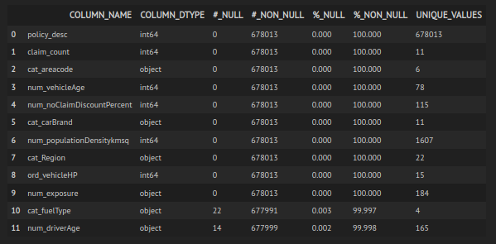
Anything else?
Yes!
cat_fuelType → 22 null entries (or missing blank), i.e. 0.003%
num_driverAge → 14 null entries (or missing blank), i.e. 0.002%

Slide 6
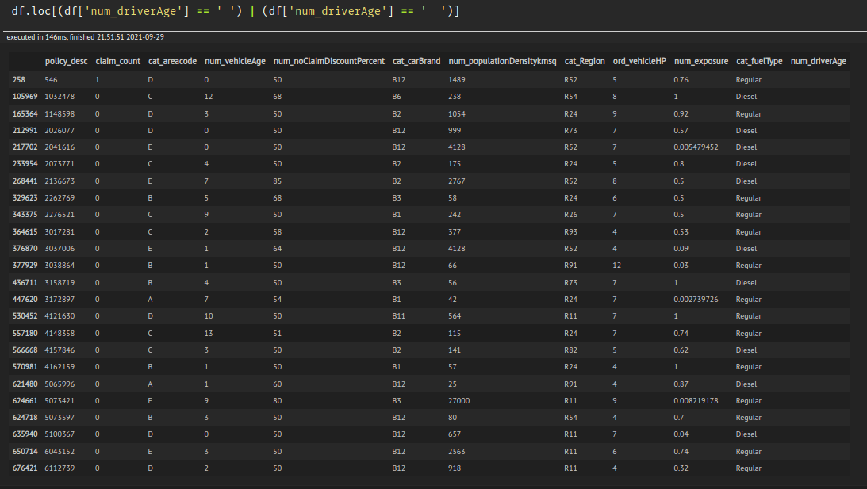
And...
Some data type irregularities
num_exporuse → was loaded as an object, however it must be a numerical variable (more specifically float64).
num_driveAge → was loaded as an object, however it must be a numerical variable.
Moreover
num_driveAge → there're string entries as well as numeric entries.
- There're also Not A Number entries (nan) and missing values (string spaces).
- String spaces corresponds to 24 entries, which is 0.007% of the dataset (splitted).
- Nan corresponds to 0.011%.
(*) The effect of removing these rows most likely won't interfere in the final result.

Slide 7
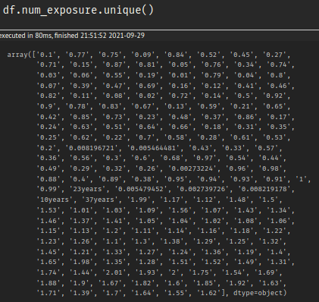
And...
Some data type irregularities
num_exporuse → was loaded as an object, however it must be a numerical variable (more specifically float64).
num_driveAge → was loaded as an object, however it must be a numerical variable.
Moreover
num_exporuse → was loaded as an object, however it must be a numerical variable (more specifically float64).
- There were entries in num_exposure which ended with "years".
cat_fuelType → array(['Regular', 'Diesel', nan, 'Electric'], dtype=object)
* Regular: 51.01%
* Diesel: 48.99%
* Electric: 0.002%
(*) The nan entries will be replaced by Not Informed (NI)

Slide 8
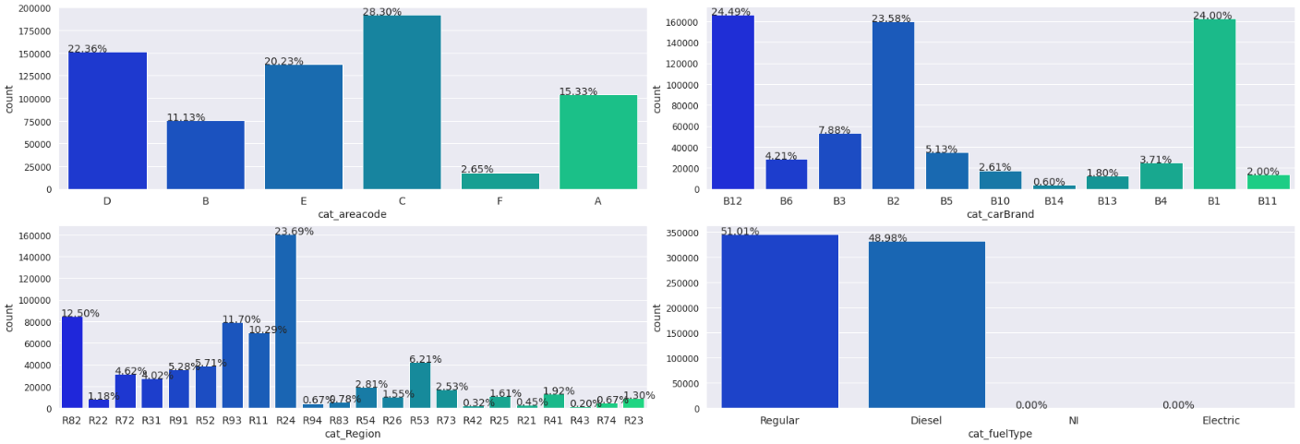
Story time!
Once upon a time a dataset...
Univariate EDA

Slide 9
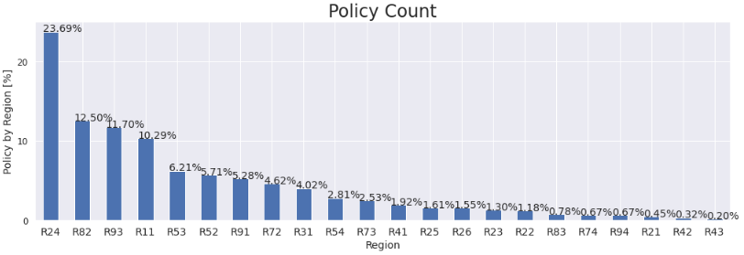
Univariate EDA
Area: cat_areacode
Area C + D + E correspond to approximately 71% of the whole entries in the dataset.
But there's one area (F) that has a very low presence (3%).
The remaining A + B areas states for 26%
Fuels: cat_fuelType
Fuel Diesel + Regular takes over most of the dataset, ~99.9%.
There're some entries which corresponds to Electric, but is very "insignificant" in comparison with Diesel and Regular.
Moreover, there were some missing values, which were marked as Not Informed (NI), but it also corresponds to a insignificant amount of entries.
Region: cat_Region
There'a a pick in Region R24 which corresponds to ~24% of the whole entries.
However, regions R11 + R24 + R82 + R93 account to approximately 58% of the dataset.
The remaining regions account to approximately 42%.
Brand: cat_carBrand
Brand B1 + B2 + B12 correspond to approximately 72.0% of the whole entries in the dataset.
Brand B3 + B5 group is the second most significant in size, but it's just 13%.
The rest of the brands correspond to ~15%

Slide 10
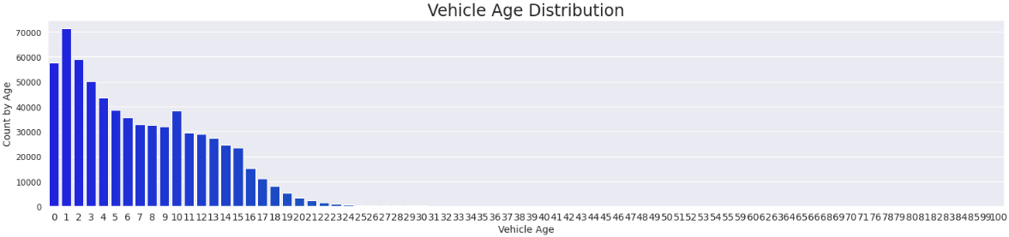
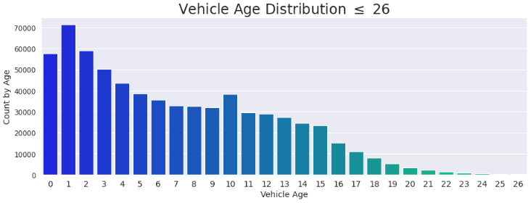
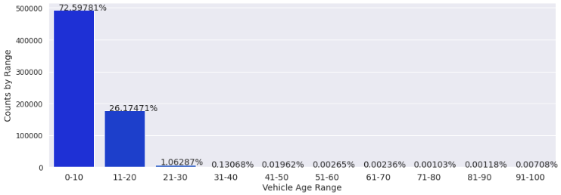
Univariate EDA
Most of the vihicles (~73%) appears to be concentrated in the age range 0 .LE. age .LE. 10.
~27% are in the interval 10 .LE. age .LE. 20.

Slide 11
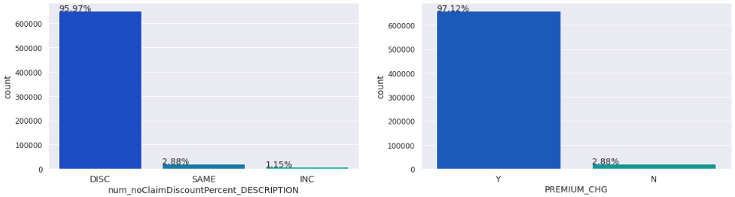
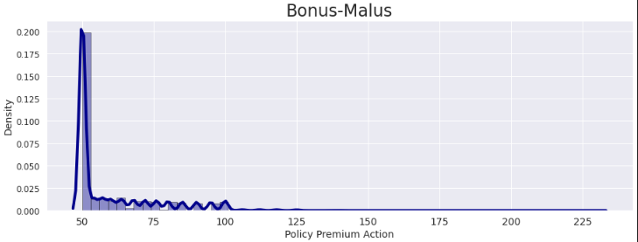
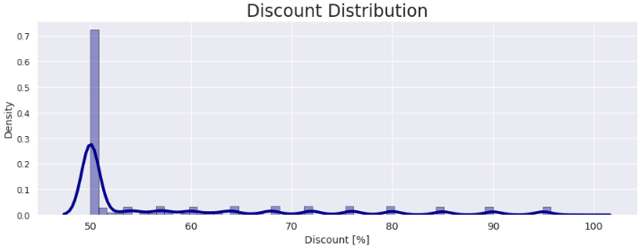
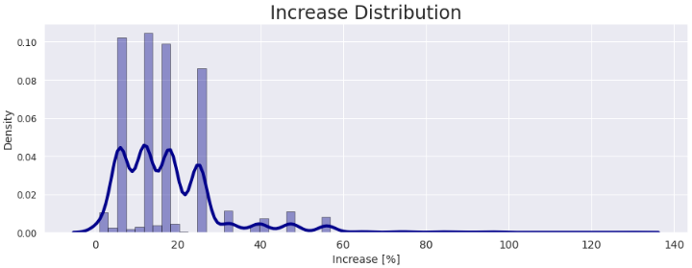
Univariate EDA
Almost 96% corresponds to discounts applied to policy premium.
~3% of the policy premium remain unchanged.
And just ~1.2% actually had an increase.
Therefore, 97% of the dataset had some kind of applied action.
It was created 5 new resources:
num_noClaimDiscountPercent_DESCRIPTION: specifies the action applied
num_PREMIUM_DISC: by how much whether the action was a discount
num_PREMIUM_INC: by how much whether the action was an increase
PREMIUM_CHG: wheter there was an action

Slide 12
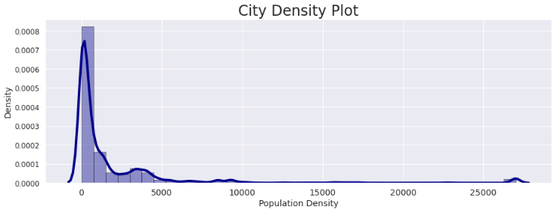
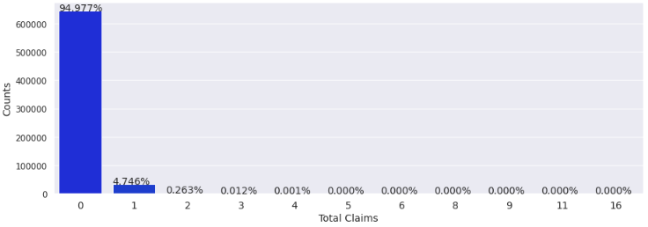
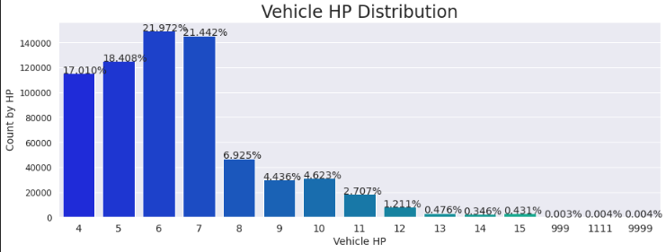
Univariate EDA
Almost 95% of the customers have no claims at all
Only ~5% of them have one claims
And less then 0.5% have 2 or more claims.
Created a new resource which states whether there was a claims: IS_CLAIM
This could be interesting to use in a classification problem. For instance, verify the propensity of a given customer made a claim. However, this would imply in a highly unbalanced dataset. One possible way out could be by means of data augmentation (unsing Random Oversampling in the lowest classification, Over and Under Sampling, or using a sintetic algorithm that generates data, *e.g.* SMOTE. On the other hand, depending on the ML-classifier, for example XGBoost has a hyperparameter which deals with unbalanced data.)

Slide 13
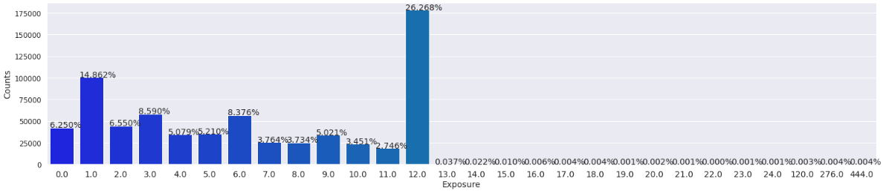
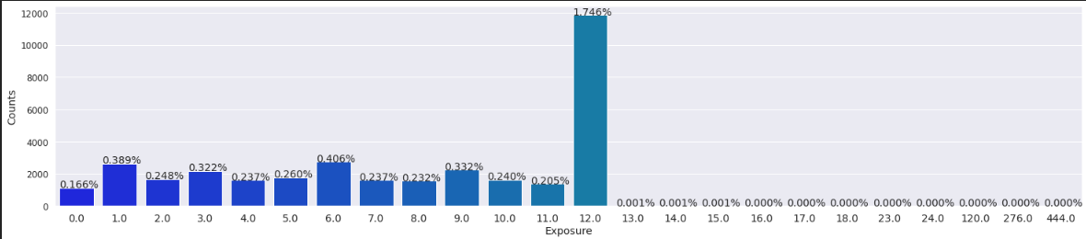
Univariate EDA
I think that I didn't quite get this info. I mean, let's work out an example:
So, taking into account that num_exposure is, by definition, the exposure time of the policy.
(*) Then, in the new column where it is represented the exposure by months, in the 12th month, which is where 26% of the customers have their exposure time policy insurance, approximately 1.7% of them actually made some claim due to any loss?

Slide 14
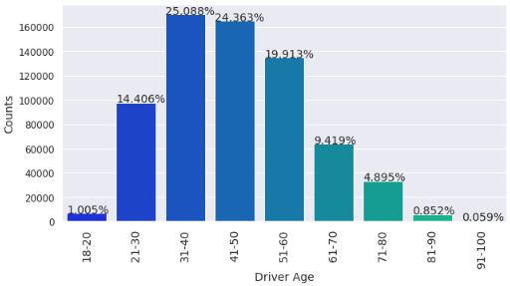
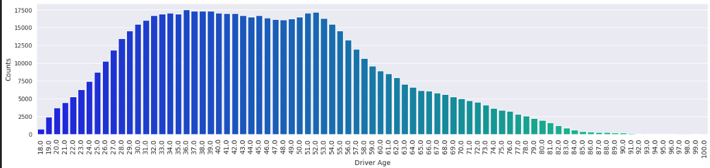
Univariate EDA
Most of the customers, ~49%, appears to be betwqeen 31 and 50 yearls old.
It was created a two new resource which is:
The driver age range: num_driverAge_RANGE

Slide 15
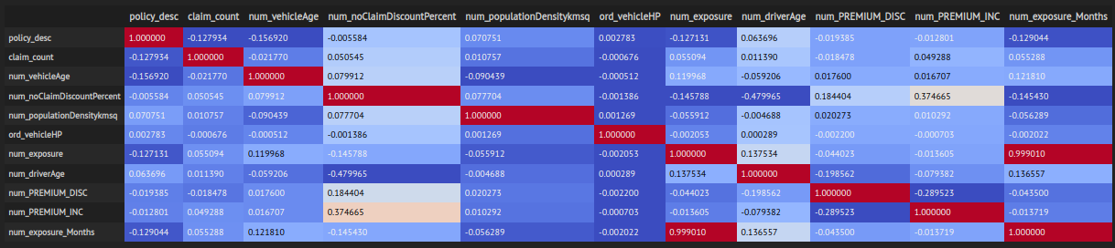
Bivariate EDA

Slide 16
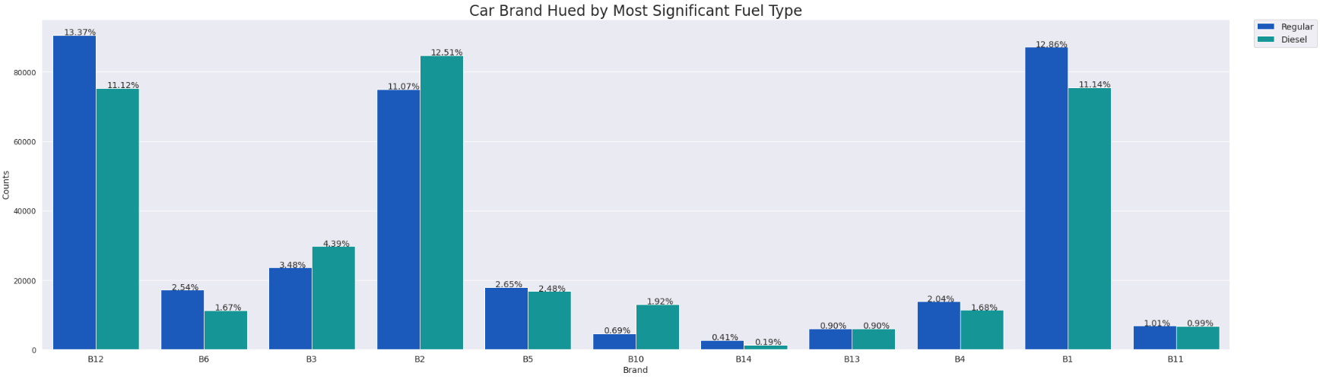
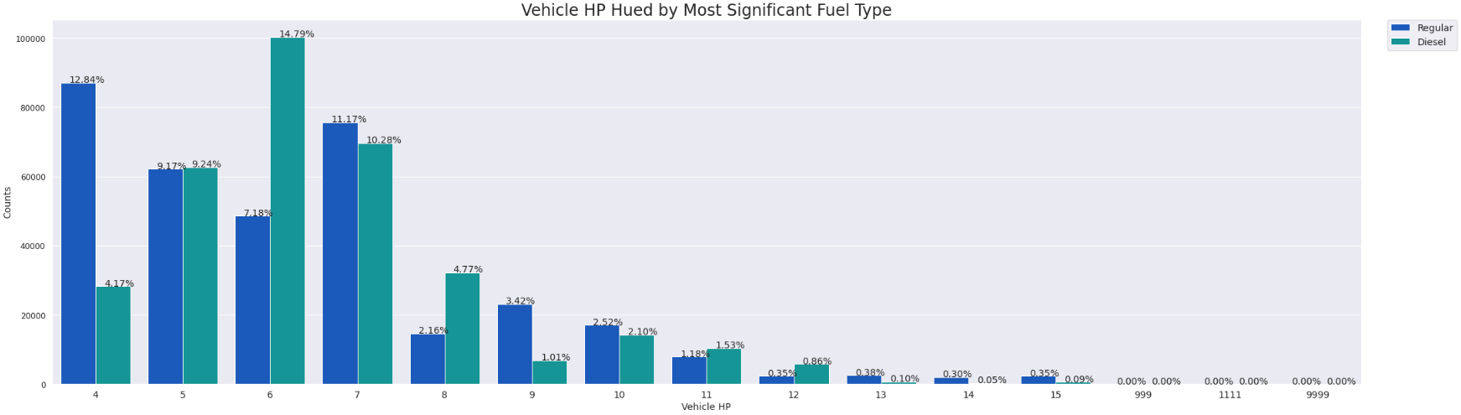
Bivariate EDA

Slide 17
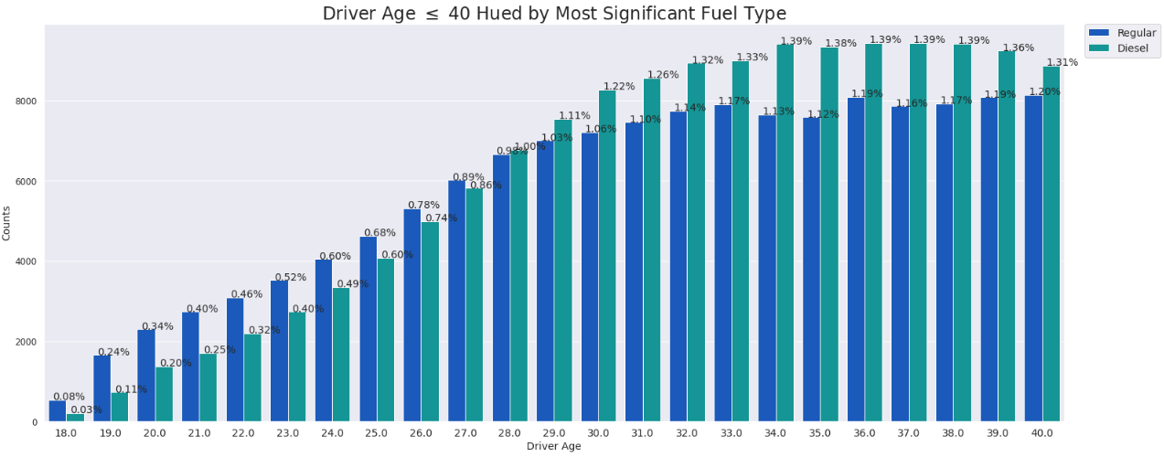
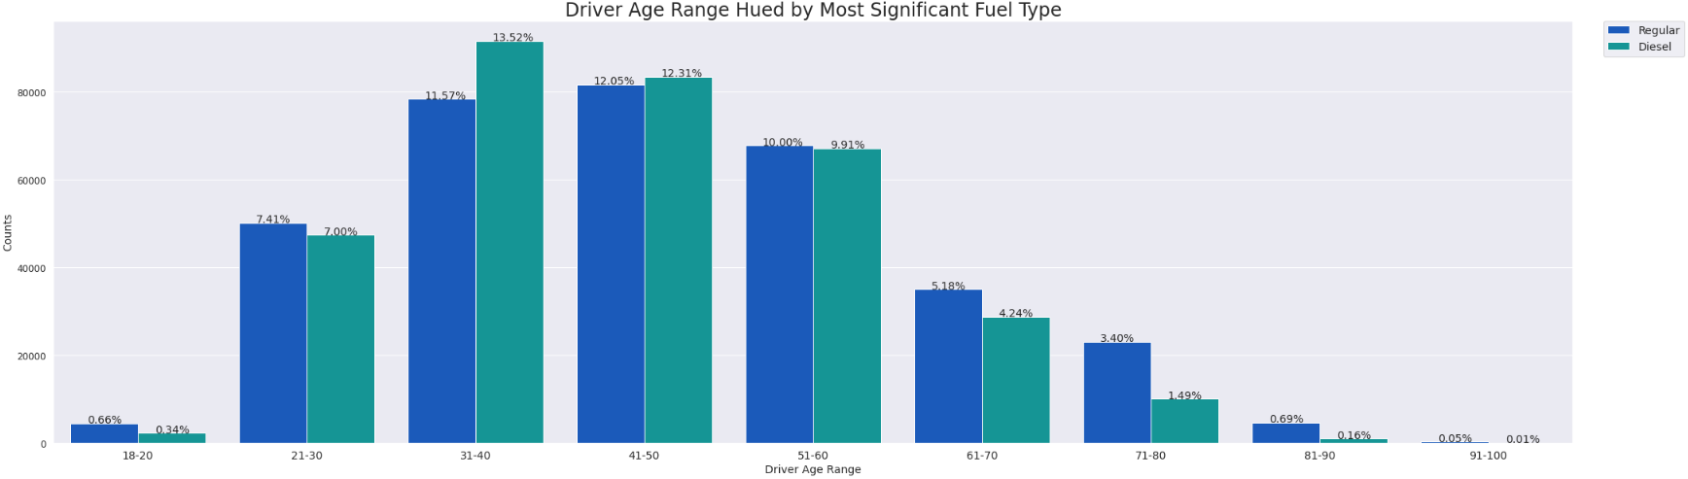
Bivariate EDA

Slide 18
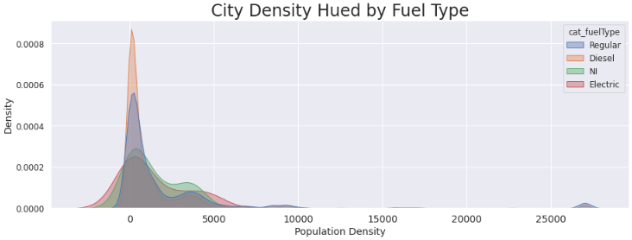
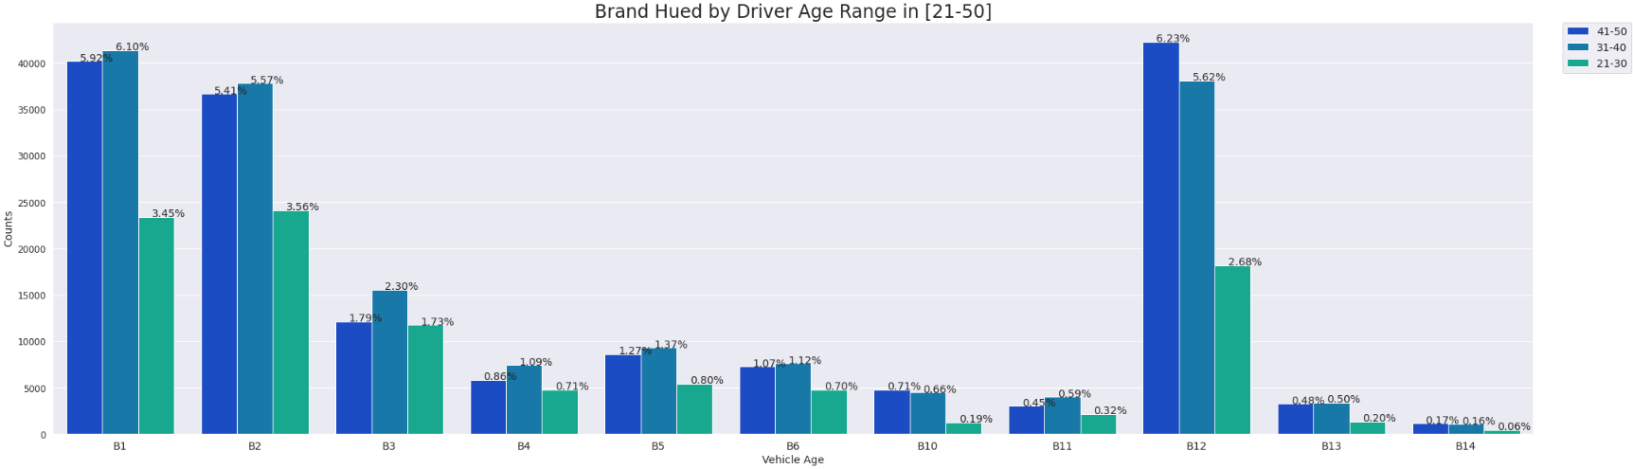
Bivariate EDA

Slide 19
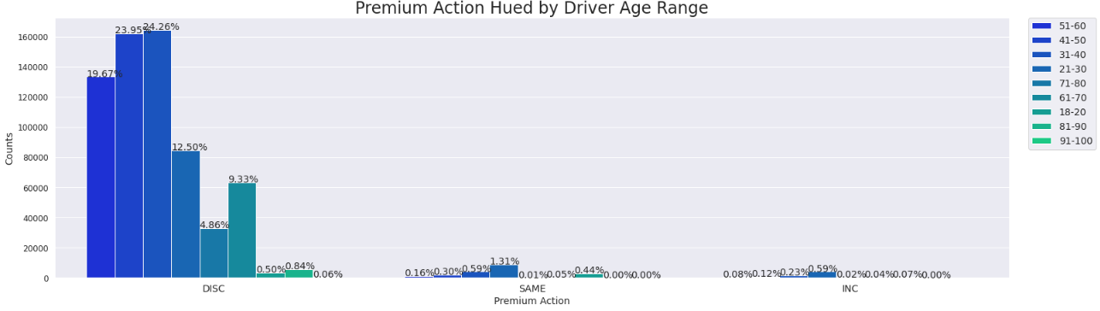
Bivariate EDA
Notice that in bivariate analysis the EDA could still spend so much time. So far, the bivariate analysis was performed using some basic key-insigths in way to gather some kind of information.
What else could be done in Bivariate and Multivariate EDA?
The limit is the imagination! We could try scatter plots to verify if there's some kind of preferred direction say Drivers' Age VS Exposure?
Check the correlation between resources. Find out if there're correlated or anticorrelated behaviours (Probably both).
And so much more.
But, let's focus on the target analysis. And the correlation between the resources.

Slide 20
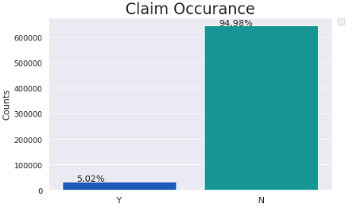
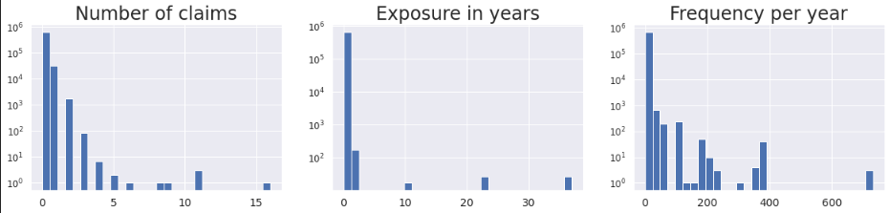
Research
This isn't exactly a pricing model, however it's the first step towards one.
What is known as loss cost model is simply predicting claim frequencies, meaning the rate of expected number of total claims by customer per unit of exposure time policy. The common trend of analyses in insurence predicting claim model shows that the distribution usually follows a Poissonian one. For this reason, the natural choice and most simple one is to start with a GLM with Poisson distribution and log-like funtion.
On one hand, following this trend the Poisson distribution, by definition, has mean equals variance. On the other hand, in real data, this isn't a given. But, and there'a a big BUT here... Let's take it for granted! :D
Claim occurance is highly skewed, *i.e.* ~95% of policies don't have any claim at all.
Some possible reason to this behaiviour usually might be associated with nonreporting claims.

Slide 21
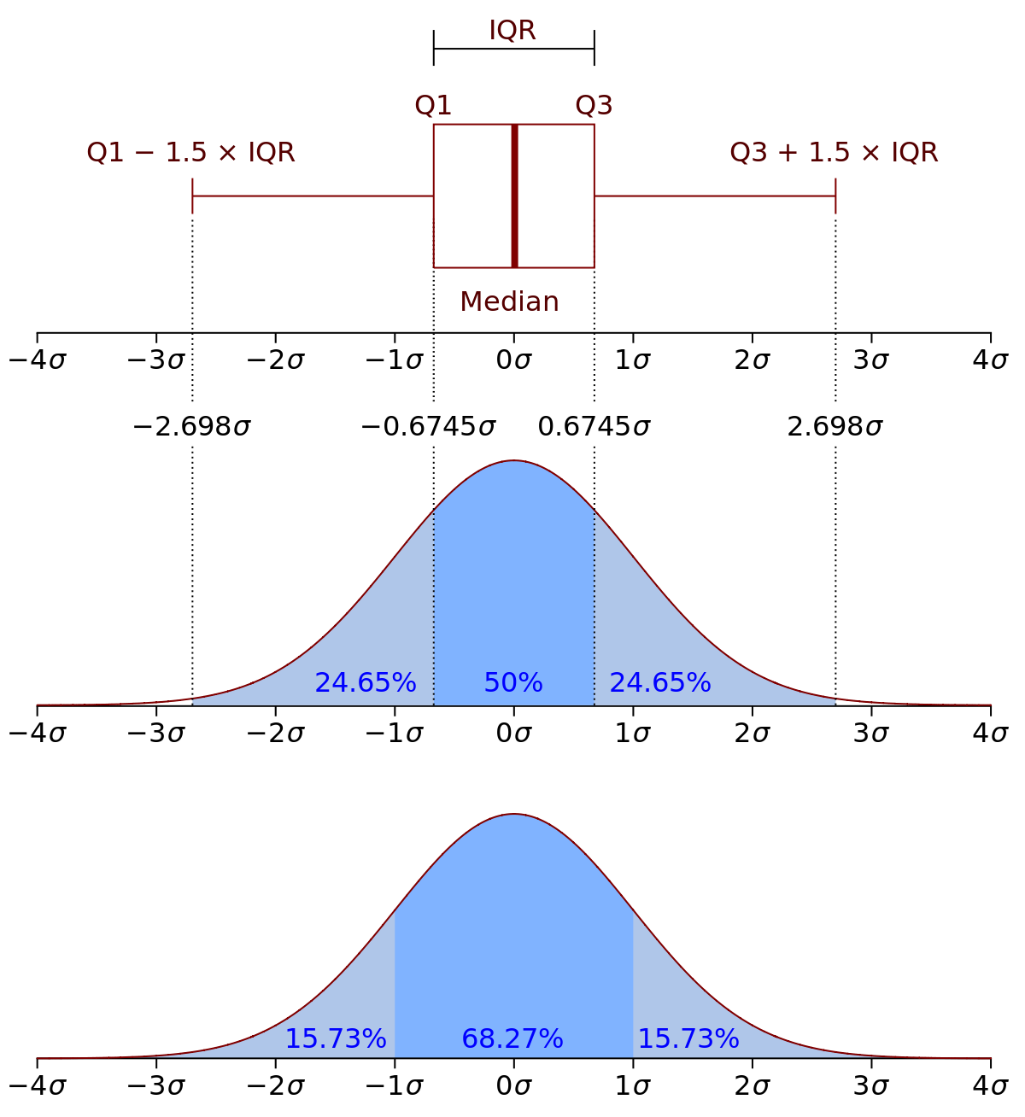
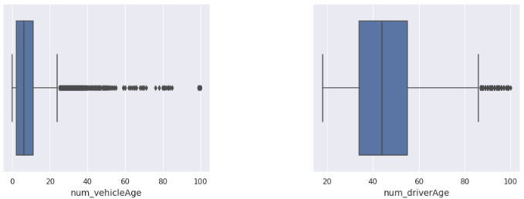

Check Outliers
The above figure is a very common way to search for outliers. This technique is called Turkey's Method and can be used to exclude data by setting as threshold the inner or outter fences:
Inner: 1.5 * Interquartile-Interval
Outter: 3.0 * Interquartile-Interval
Another method could me by means of z-scores analysis, where z is defined by $(data_{i} + data_{mean})/data_{std}$
Z-scores simply means how far away we are from the mean value in a given feature.

Slide 22
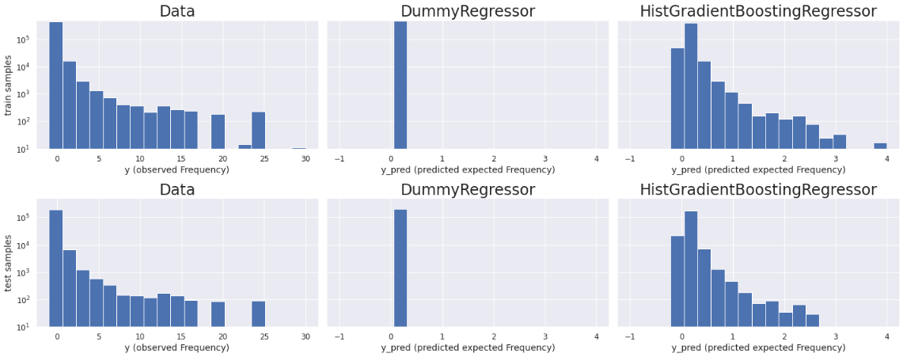
Dummy Regressor
Gradient Boosting Regression Trees for Poisson Regression
Modelling

Slide 23
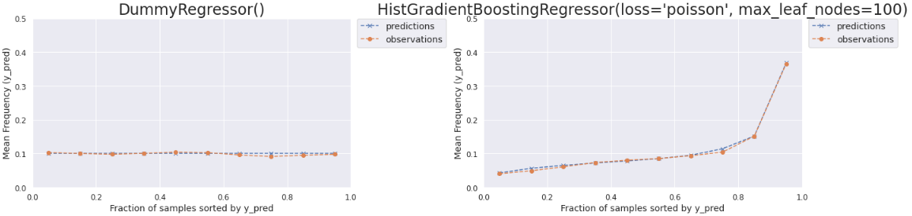
Dummy Regressor
Gradient Boosting Regression Trees for Poisson Regression
Modelling
Meaning…?
Ok, but why is it so important?
Dummy Regressor:
Predicts a constant frequency of claims by policy holder.
Gradient Boosted Tree Regressor:
Shows a much better consistency between observed targets (our ground truth) and the predicted ones (our expectation).

Slide 24
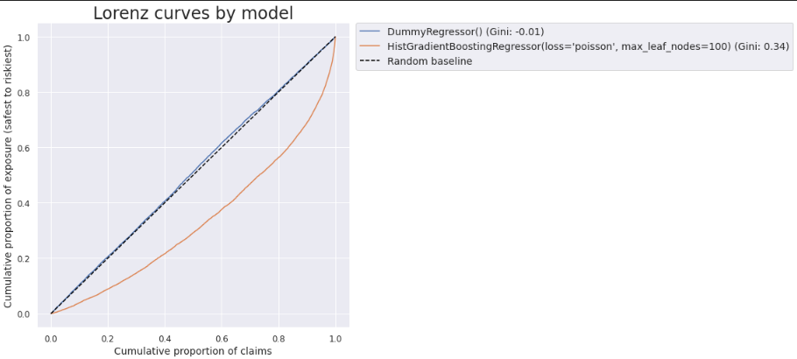
Dummy Regressor
Gradient Boosting Regression Trees for Poisson Regression
Modelling
The most important result, and what's really important to business decisions, is how to use the predicted frequency and turn it into a valuable product for tha insurance company.
In this case, probably we're most likely interest in the ability of the model to rank riskiest from the safest customers (policyholders).
However, this would be the case of casting the model evaluation as a ranking problem rather than a regression one.

